Slide 1
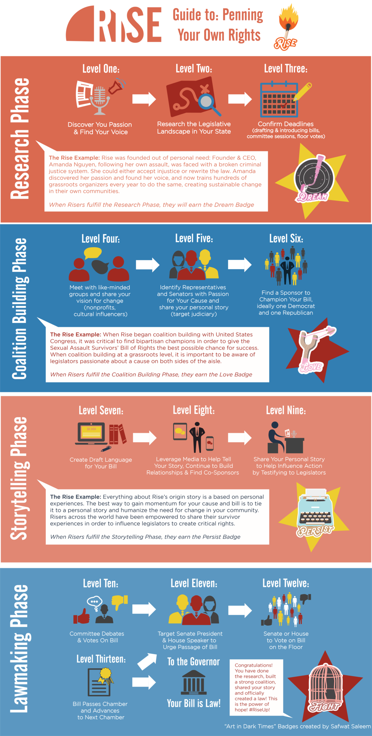

Slide 2
Research Phase
Level One: Discover Your Passion & Find Your Voice
Notes:
When handling people it is important to remember that not everyone goes through the same thought process as you and it is important to always give people the benefit of the doubt. While this can be frustrating it is what separates the best bosses from everyone else.

Slide 3
Research Phase
Level Two: Research the Legislative Landscape
Notes:
When handling people it is important to remember that not everyone goes through the same thought process as you and it is important to always give people the benefit of the doubt. While this can be frustrating it is what separates the best bosses from everyone else.

Slide 4
Research Phase
Level Three: Confirm Deadlines
Notes:
When handling people it is important to remember that not everyone goes through the same thought process as you and it is important to always give people the benefit of the doubt. While this can be frustrating it is what separates the best bosses from everyone else.

Slide 5
Coalition Building Phase
Level Four: Meet with Like-Minded Groups and Share your Vision for Change
Notes:
When handling people it is important to remember that not everyone goes through the same thought process as you and it is important to always give people the benefit of the doubt. While this can be frustrating it is what separates the best bosses from everyone else.

Slide 6
Coalition Building Phase
Level Five: Identify Legislators with Passion for Your Cause and Share Your Personal Story
Notes:
When handling people it is important to remember that not everyone goes through the same thought process as you and it is important to always give people the benefit of the doubt. While this can be frustrating it is what separates the best bosses from everyone else.

Slide 7
Coalition Building Phase
Level Six: Find a Sponsor to Champion your Bill, Ideally One from Each Party
Notes:
When handling people it is important to remember that not everyone goes through the same thought process as you and it is important to always give people the benefit of the doubt. While this can be frustrating it is what separates the best bosses from everyone else.

Slide 8
Story Telling Phase
Level Seven: Create Draft Bill Language
Notes:
When handling people it is important to remember that not everyone goes through the same thought process as you and it is important to always give people the benefit of the doubt. While this can be frustrating it is what separates the best bosses from everyone else.

Slide 9
Story Telling Phase
Level Eight: Leverage Media to Help Tell Your Story, Continue to Build Relationships & Find Co-Sponsor
Notes:
When handling people it is important to remember that not everyone goes through the same thought process as you and it is important to always give people the benefit of the doubt. While this can be frustrating it is what separates the best bosses from everyone else.

Slide 10
Story Telling Phase
Level Nine: Share Your Personal Story Help Influence Action by Testifying to Legislators
Notes:
When handling people it is important to remember that not everyone goes through the same thought process as you and it is important to always give people the benefit of the doubt. While this can be frustrating it is what separates the best bosses from everyone else.

Slide 11
Law Making Phase
Level Ten: Committee Debates & Votes on Bill
Notes:
When handling people it is important to remember that not everyone goes through the same thought process as you and it is important to always give people the benefit of the doubt. While this can be frustrating it is what separates the best bosses from everyone else.

Slide 12
Law Making Phase
Level Eleven: Target Leadership to Urge Passage of Bill
Notes:
When handling people it is important to remember that not everyone goes through the same thought process as you and it is important to always give people the benefit of the doubt. While this can be frustrating it is what separates the best bosses from everyone else.

Slide 13
Law Making Phase
Level Thirteen: Bill Passes Chamber and Advances
Notes:
When handling people it is important to remember that not everyone goes through the same thought process as you and it is important to always give people the benefit of the doubt. While this can be frustrating it is what separates the best bosses from everyone else.

